Slide 1
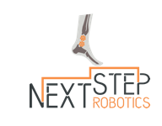
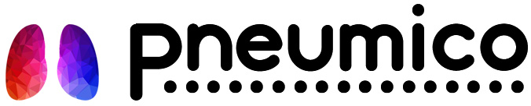



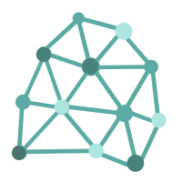
NeuroSonics
Focused ultrasound tools and techniques for surgery.
Next Step Robotics
Robotic tools for rehabilitation of stroke victims.
Pneumico
Safer manual ventilation using artificial intelligence and feedback.
Awarables
Developing tools to treat insomnia and other sleep disorders.
Sonosa
Working to diagnose and treat obstructive sleep apnea.
Aerea
Developing life-changing therapies for respiratory diseases
Connected Care Systems
Using digital health tools to improve quality and efficiency of healthcare.
Connected Care

